Slide 1
AIR-423 Long Term Solution to cloud.gov container size limitation AIR-441 PDF Location stability
Done: Move the 5 largest files from the 2018 National Air Quality Conference to “document.airnow.gov”
New Files: Use the updated “Adding New Publications” procedure. That procedure will guide you if they are “large” (AIR-423) or need a “Permanent File Name” (AIR-441).
Monthly: Run the “Remove Unused Files” procedure to clean up old files
Quarterly: Run the “Migrating the 5 Largest Files” procedure.

Slide 2
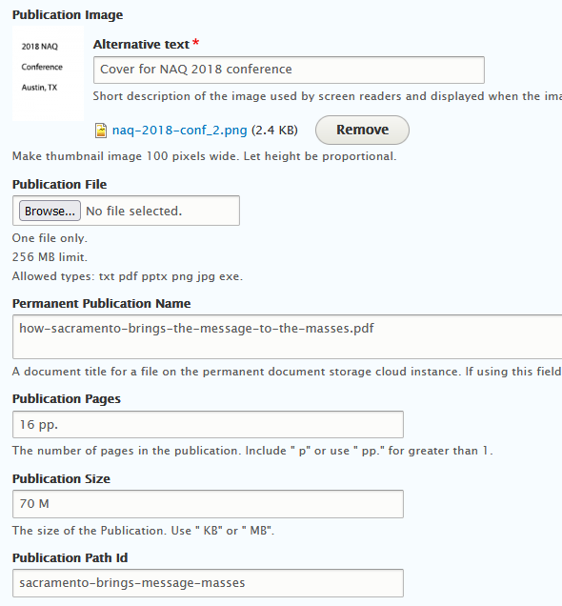
Large File Example in Drupal Taxonomy

